Slide 1


Slide 2
CSS

Slide 3
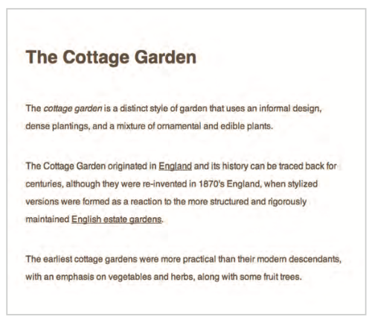
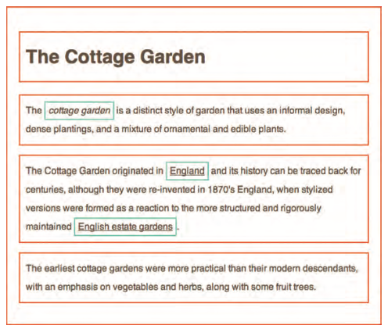
Thinking Inside The Box
Imagine an invisible box around every HTML element
CSS allows you to define how each box is presented

Slide 4
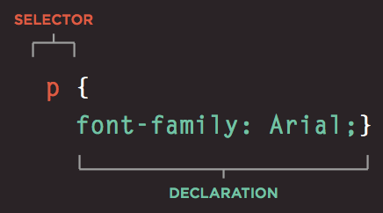
Associating Style With an HTML Element
CSS works by associating rules with HTML elements
Rule is constructed of
Selector – for which element style should be used
Declaration – how element should be styled

Slide 5
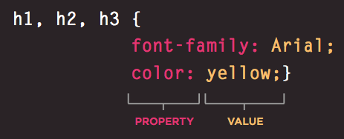
CSS Properties
Declaration
Property – aspect of the element that should be changed
Value – settings that should be used
Using one rule for multiple elements

Slide 6


CSS Selectors
Applying a rule to a specific element (element targeting)
Universal selector
Applies to all elements in the document
Type selector
Matches element names

Slide 7


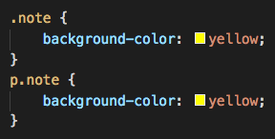

ID and Class Selectors
ID
Matches an element based on element id attribute value
Class
Matches an element based on element class attribute value

Slide 8
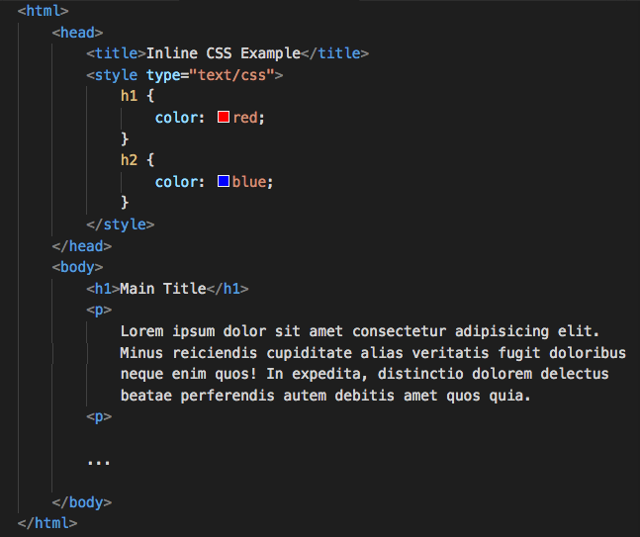
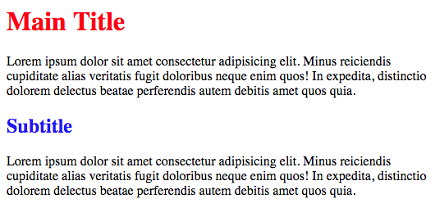
Using CSS on page
Internal CSS
External CSS
<style> element is used for ”internal” (on-page) CSS

Slide 9


Exercise
Notes:
Starting with the bootcamp
Hoping to catch the wave and achieve much more

Slide 10

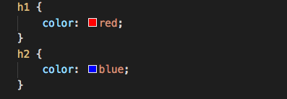
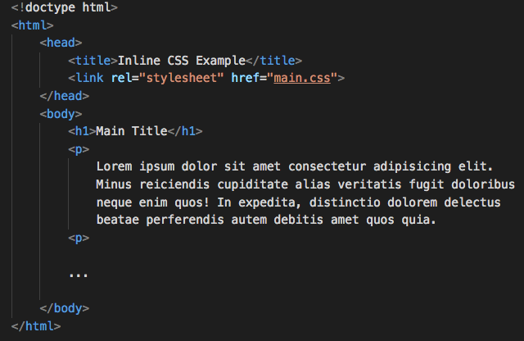
External CSS
CSS is located in a separate file
<link> element is used for including CSS on page

Slide 11
Exercise
Notes:
Starting with the bootcamp
Hoping to catch the wave and achieve much more

Slide 12



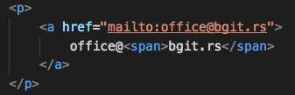
Child and Descendant Selectors
Child
Matches an element that is a direct child of another
Descendant
Matches an element that is a descendent of another specified element

Slide 13
Exercises
Notes:
Starting with the bootcamp
Hoping to catch the wave and achieve much more

Slide 14

Defining Rules Correctly
When there is multiple rules defined for the same element, which rule will be used?
Last rule – when both selectors are identical, last one will be used
More specific – if one is more specific than the other, the more specific one will be used
Important – rule property can be append with !important, and it will be treated as a property with higher priority

Slide 15
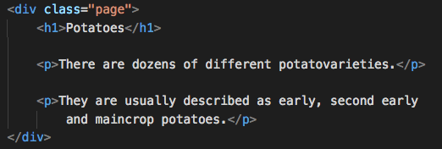
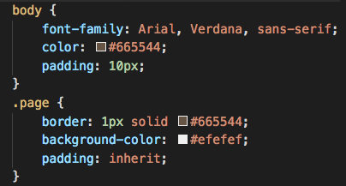
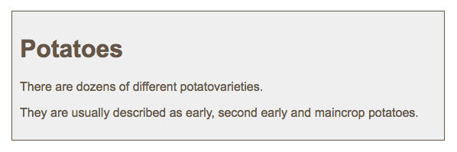
CSS Rules Inheritance
Parent element property is propagated on child elements
Force a child property to use a parent’s property value (inherit)

Slide 16
Exercises
Notes:
Starting with the bootcamp
Hoping to catch the wave and achieve much more

Slide 17
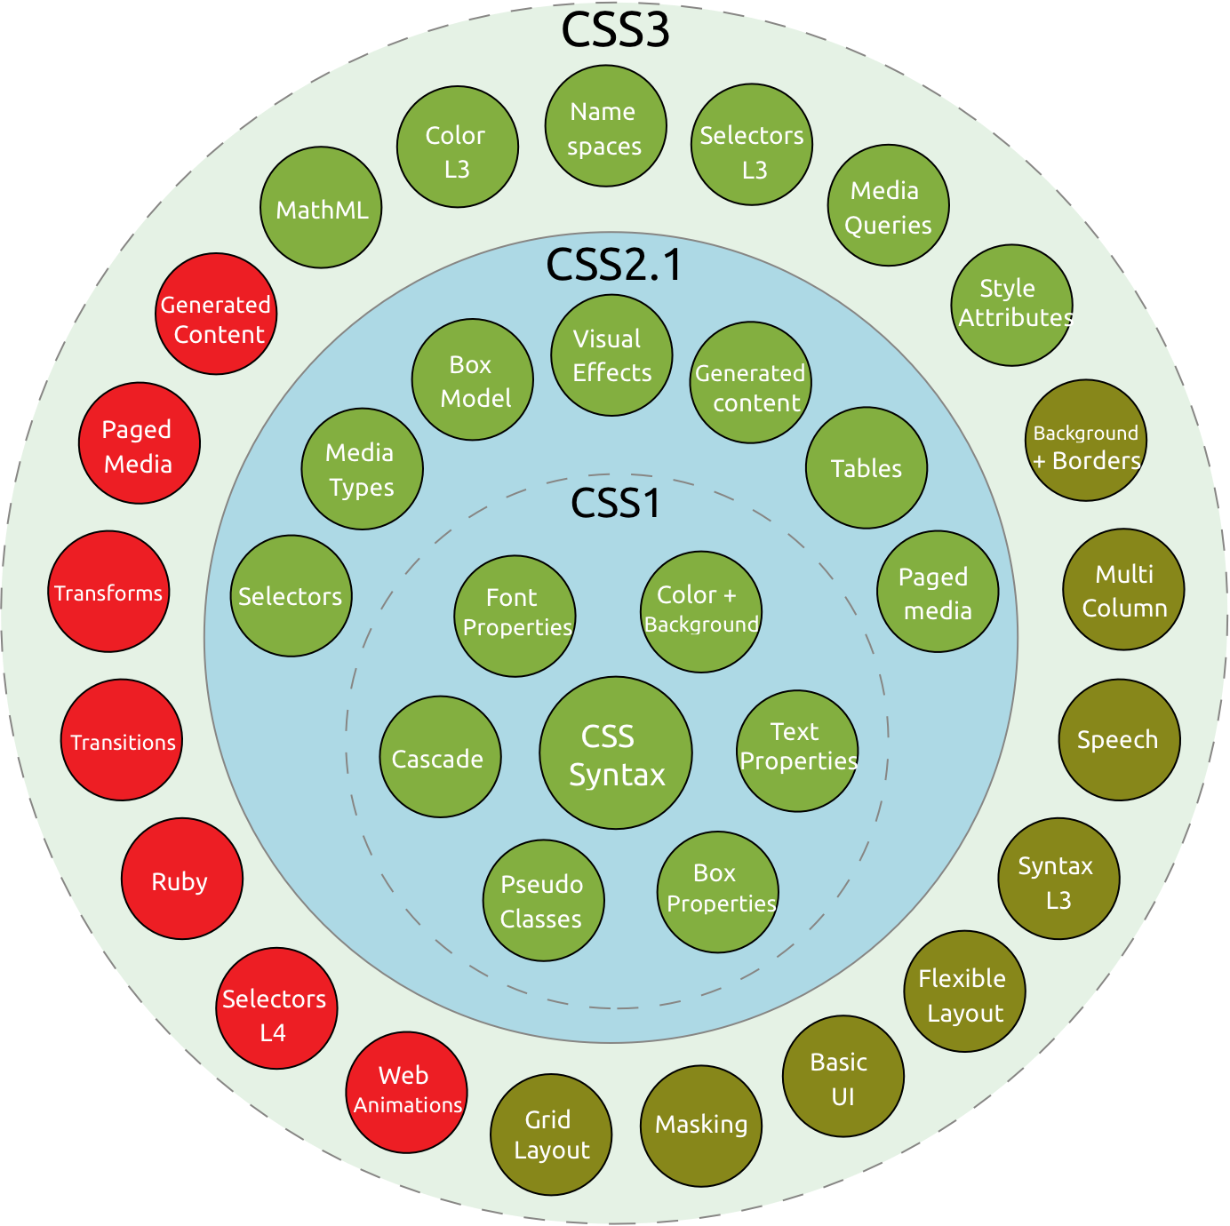
CSS versions
CSS1 released in 1996
CSS2 released in 1998
CSS3 currently in development
Browser support https://caniuse.com/
Browsers can show some styles slightly different
Check the website in different browsers
Use one of online services to see what the website looks like in different browsers

Slide 18
Summary
CSS treats each HTML element as if it appears inside its own box and uses rules to indicate how that element should look.
Rules are made up of selectors and declarations.
Different types of selectors allow you to target your rules at different elements.
Declarations are made up of two parts: the properties of the element that you want to change, and the values of those properties.
CSS rules usually appear in a separate document, although they may appear within an HTML page.

Slide 19
References
CSS History - https://goo.gl/9eU6VA

